Slide 1
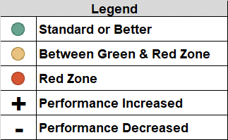
Brevard Family Partnership
Quarterly Contract & Scorecard Measures Trends

