Slide 1
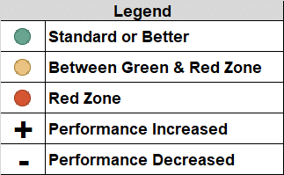
Brevard Family Partnership
Contract & Scorecard Measures Trends
for May 2020 (On Demand Listing)

