Slide 1
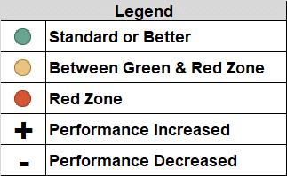
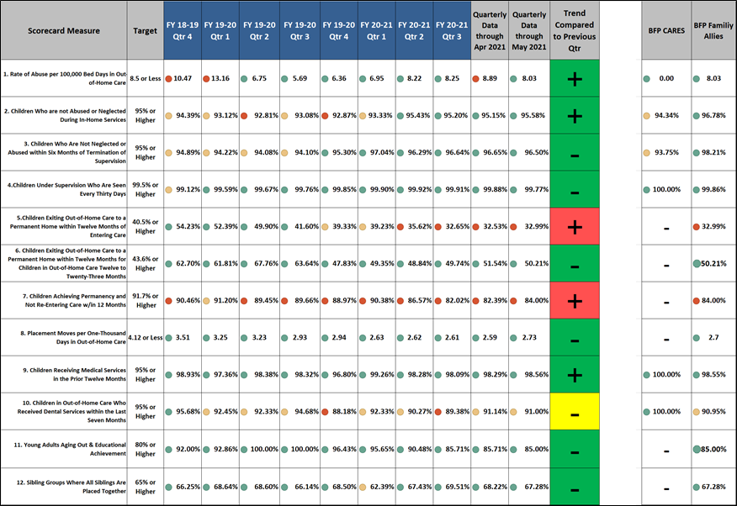
Brevard Family Partnership
Contract & Scorecard Measures Trends
for May 2021 (Unofficial Listing)

