Slide 1

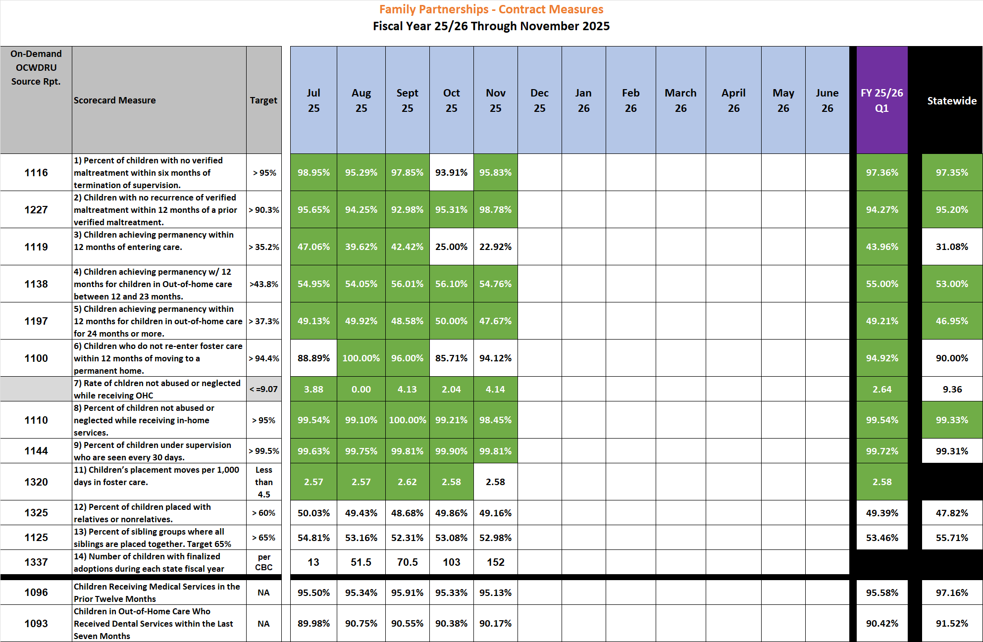
Family Partnerships of Central Florida-- CBC Contract Measures – Fiscal Year to Date 23/34 through November 2025

